Slide 1
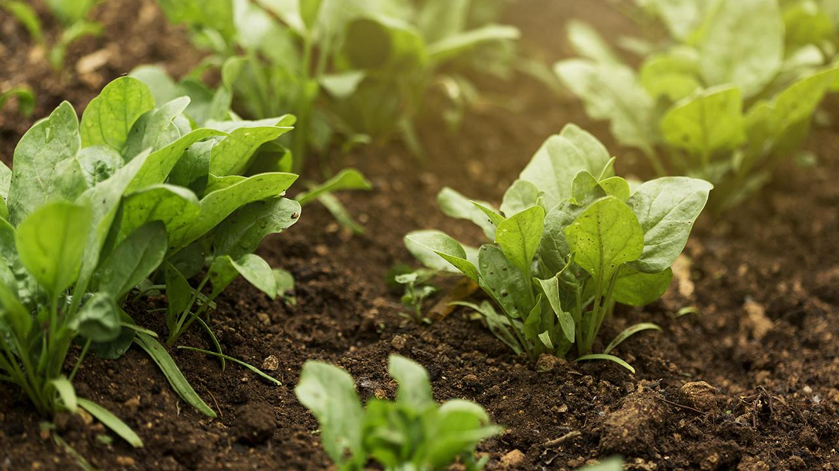
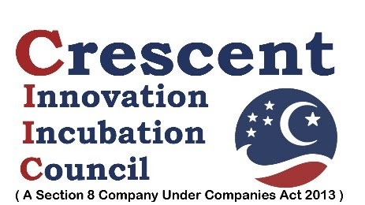

CONNECTaTHON
PROBLEM STATEMENT:
Improper Selection of crops and Lack of organic practices have affected the yield of farmers in Tamil Nadu.. Out of 61 Lakh acres of agricultural land only 31687 acres of land has been registered under organic certification by 4768 farmers in Tamil Nadu which accounts for meager 1 percent of total land.
The agricultural lands have been used for growing crops for years without caring much for replenishing. This has led to depletion and exhaustion of soils resulting in their low productivity. The average yields of almost all the crops are among the lowest.
Lack of Precision Farming Practices are hurting the crop yields.

Slide 2
Existing Solution:
CROP SUGGESTER:
The existing crop suggesting algorithms recommend a single crop based on the soil conditions as their only constraints.
These solutions do not take into account the demand of the crops and the financial constraints of the farmers.
SUPPLYING NUTRIENTS:
As said in the problem statement only about 1 percent of farmers in Tamil Nadu employ organic farming and bio-fertilizers.
Rest of the farmers use chemical based fertilizers and pesticides.

Slide 3
How is Our Solution Different ?
CROP SUGGESTER:
Considers both soil conditions and the demand of the crops and the financial constraints of the farmer.
Suggests crops by considering the previous history of crops sown and profits earned
SUPPLYING NUTRIENTS:
Organic farming based methods and organic manures will be suggested.
This helps farmers to convert to organic way of farming.

Slide 4
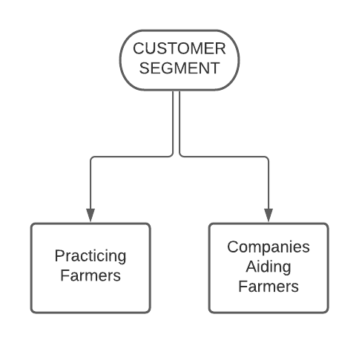
CUSTOMER SEGMENT:

Slide 5
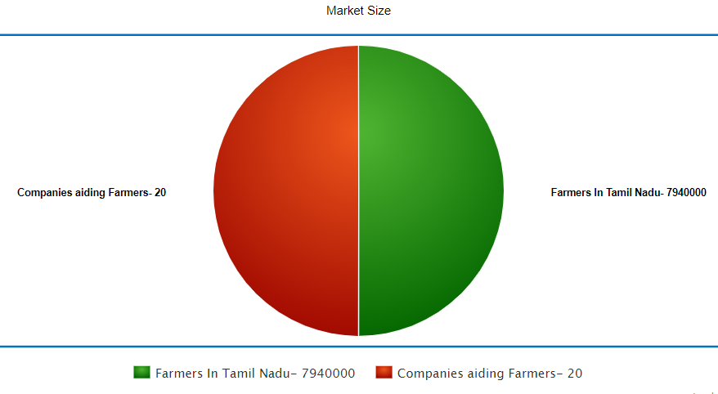
NICHE MARKET:

Slide 6
Ease and Feasibility of Our Product:
We have a easy to use website interface where just by entering the details you get the crop recommendations, based on which a farmer can choose his crop based on availability of the raw materials.
Also we give the details for organic farming and health monitoring methods for a particular crop which is relevant for a particular crop and can be implemented with the basic materials.
Also using our organic farming methods the farmers can cut down their expenses and improve their profits and at the same time improve the quality of the existing yield.
FUTURE SCOPE:
A mobile app can be developed for the same.
For the easy accessibility of the farmers, the suggestions can be sent as an sms or a voice message in their regional language.

